Slide 1

RESTful Web Service Implementation + Docker (using Python & Flask)
Sanath Gholap
Rohan Singh

Slide 2
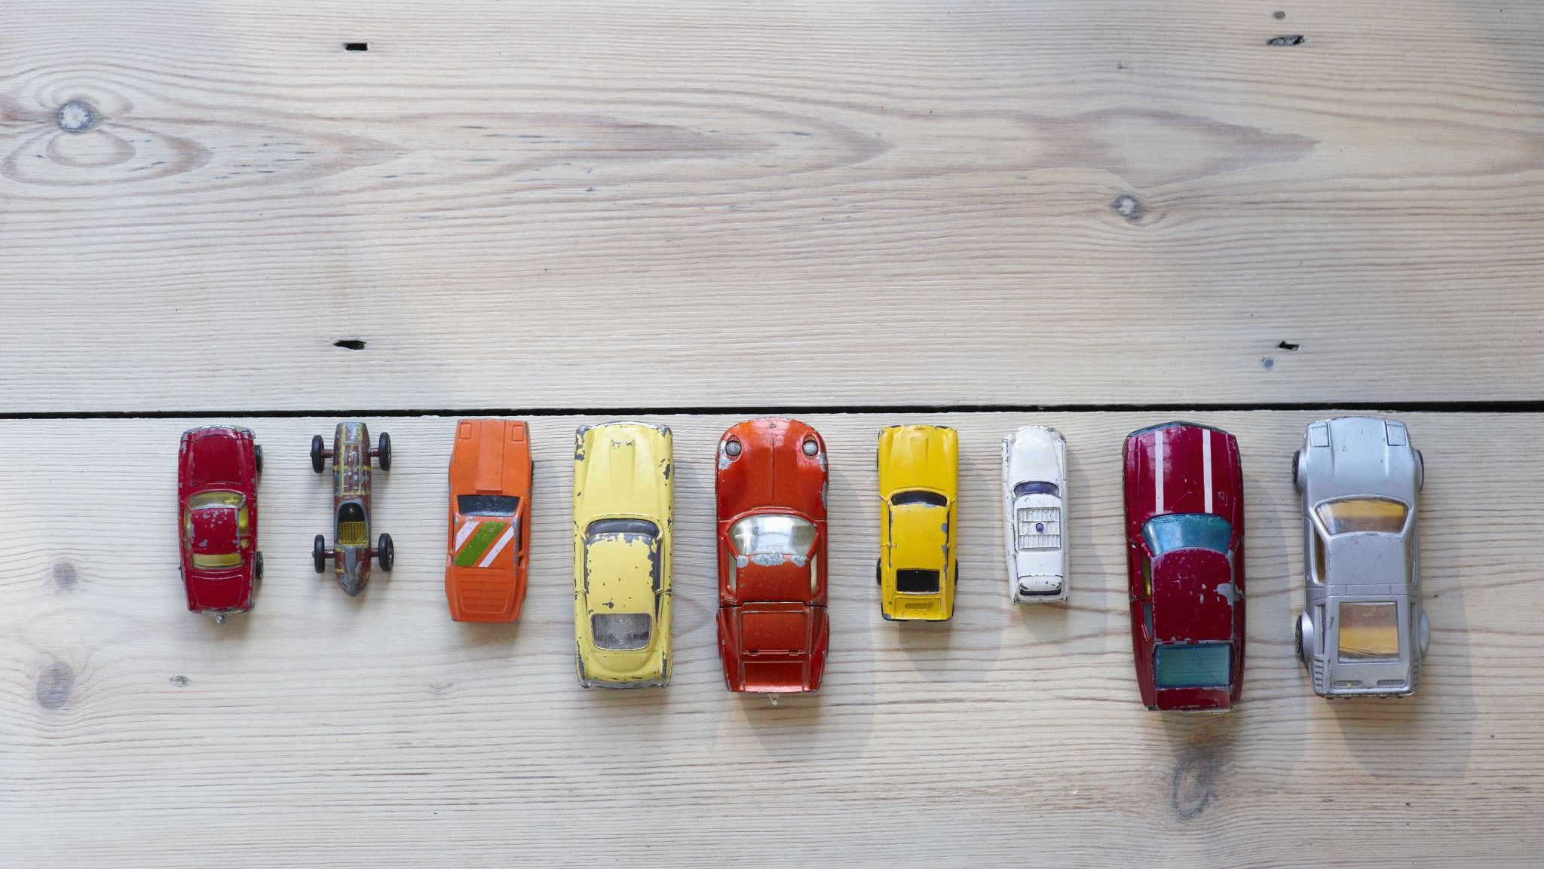
Data Model
This assignment consists of a database file focused on JSON, cars.json, which consists of a set of car models with their corresponding characteristics such as ID, name, brand, horsepower, mileage and year.
App.py Python loads the JSON file and shows the data according to the routes in the tab. The service contains 4 GET routes-
A list of all car models with their ID, name, brand, horsepower, mileage and year is seen on the "/car-management/" route.
The path "/car-management/<Year>/" indicates the specifics of a car model for the year in question.
The route "/car-management/<Year>/<ID>/" reveals the specifics of a given ID in the year in question.
The route "/car-management/<Year>/<ID>/Horsepower/" indicates the horsepower specifics of a particular ID in that respective year.
The files are compiled into an image that runs in the container of a Docker.

